Slide 1

INSTITUTE - UIE
DEPARTMENT- ACADEMIC UNIT-2
Bachelor of Engineering (Computer Science & Engineering)
Subject Name: Object Oriented Programming using C++
Code:20CST151
Unit-1
Topic: Features of object-oriented programming, Difference between object oriented and procedure-oriented programming
DISCOVER . LEARN . EMPOWER

Slide 2


Object Oriented Programming using C++
Course Objectives
To enable the students to understand various stages and constructs of C++ programming language and relate them to engineering programming problems.
To improve their ability to analyze and address variety of problems in programming domains.

Slide 3



Course Outcomes
CO Number | Title | Level
CO1 | Provide the environment that allows students to understand object-oriented programming Concepts. | Understand
CO2 | Demonstrate basic experimental skills for differentiating between object-oriented and procedural programming paradigms and the advantages of object-oriented programs. | Remember
CO3 | Demonstrate their coding skill on complex programming concepts and use it for generating solutions for engineering and mathematical problems. | Understand
CO4 | Develop skills to understand the application of classes, objects, constructors, destructors, inheritance, operator overloading and polymorphism, pointers, virtual functions, exception handling, file operations and handling. | Understand

Slide 4
Scheme of Evaluation
Sr. No. | Type of Assessment Task | Weightage of actual conduct | Frequency of Task | Final Weightage in Internal Assessment (Prorated Marks) | Remarks
1. | Assignment* | 10 marks of each assignment | One Per Unit | 10 marks | As applicable to course types depicted above.
2. | Time Bound Surprise Test | 12 marks for each test | One per Unit | 4 marks | As applicable to course types depicted above.
3. | Quiz | 4 marks of each quiz | 2 per Unit | 4marks | As applicable to course types depicted above.
4. | Mid-Semester Test** | 20 marks for one MST. | 2 per semester | 20 marks | As applicable to course types depicted above.
5. | Presentation*** |  |  | Non Graded: Engagement Task | Only for Self Study MNGCourses.
6. | Homework | NA | One per lecture topic (of 2 questions) | Non-Graded: Engagement Task | As applicable to course types depicted above.
7. | Discussion Forum | NA | One per Chapter | Non Graded: Engagement Task | As applicable to course types depicted above.
8. | Attendance and Engagement Score on BB | NA | NA | 2 marks

Slide 5
CONTENTS
Introduction to C++ Programming
Features of object-oriented programming
Difference between object oriented and procedure-oriented programming
Notes:
Computer in the diagram is 3rd generation computer. The period of third generation was from 1965-1971. The computers of third generation used Integrated Circuits (ICs) in place of transistors. A single IC has many transistors, resistors, and capacitors along with the associated circuitry. The main features of third generation are −
IC used
More reliable in comparison to previous two generations
Smaller size
Generated less heat
Faster
Lesser maintenance
Costly
AC required
Consumed lesser electricity
Supported high-level language

Slide 6
Introduction to C++ Programming
The prime purpose of C++ programming was to add object orientation to the C programming language, which is in itself one of the most powerful programming languages.
The core of the pure object-oriented programming is to create an object, in code, that has certain properties and methods. While designing C++ modules, we try to see whole world in the form of objects.
For example a car is an object which has certain properties such as color, number of doors, and the like. It also has certain methods such as accelerate, brake, and so on.

Slide 7
Properties of C++ Programming
Data as well as operations are encapsulated in objects
Information hiding is used to protect internal properties of an object
Objects interact by means of message passing.
In most object-oriented languages objects are grouped in classes
Objects in classes are similar enough to allow programming of the classes, as opposed to programming of the individual objects
Classes represent concepts whereas objects represent phenomena
Classes are organized in inheritance hierarchies. Provides for class extension or specialization

Slide 8
Features of Object-Oriented Programming
Object
Class
Data abstraction and Encapsulation
Information hiding
Inheritance
Polymorphism

Slide 9
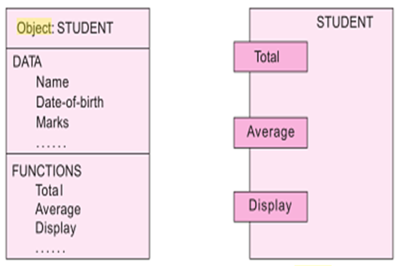
Object
Object is a instance of class.
Represent a person, a place, a bank account, a table of data or any item the program has to handle.
Fig.1. Two ways of representing an object

Slide 10
Class
Set of data & code of an object ->user-defined data type –>class.
Once a class has been defined, we can create any number of objects belonging to that class.
A class is collection of objects of similar type.
Syntax used to create an object is no different than the syntax used to create an integer object in C.
Example-- If fruit has been defined as a class, then the statement
fruit mango;
will create an object mango belonging to the class fruit.

Slide 11
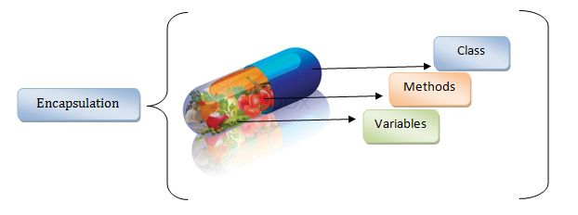
Data Abstraction & Encapsulation
Wrapping up of data & functions into a single unit (called class) -encapsulation.
Data is not accessible to the outside world
Functions which are wrapped in the class can access it.
Abstraction - act of representing essential features without background details.
Fig.2. Encapsulation

Slide 12
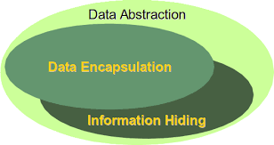
Information Hiding
Insulation of data from direct access by the program – data or information hiding.
Attributes are - data members because they hold information.
Functions are - member functions.
Fig.3. Concept of Information Hiding

Slide 13
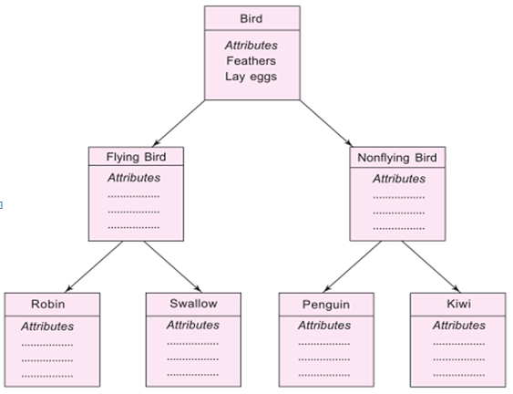
Inheritance
Process by which objects of one class acquire the properties of objects of another class.
Each derived class shares common characteristics with the class from which it is derived(fig.4).
Inheritance provides reusability and expandability.
Fig. 4. Property Inheritance

Slide 14
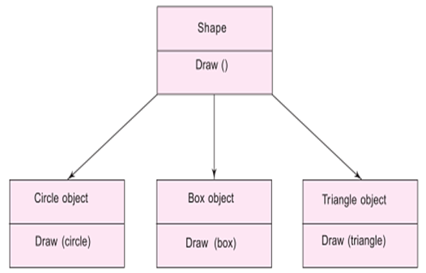
Polymorphism
Ability to take more than one form.
An operation may exhibit different behaviours in different instances.
Using a single function name to perform different types of tasks is known as function overloading(fig.5).
Fig. 5. Polymorphism

Slide 15
Difference between object oriented and procedure-oriented programming
Procedure-oriented programming | Object-oriented programming
Emphasis is on doing things. | Emphasis is on data rather than procedure.
Large programs divided into smaller functions(fig.1). | Programs are divided into objects.
Functions can share global data(fig.2). | Functions that operate on the data of an object are tied together in the data structure.
Data move openly. | Data is hidden (fig.3).
Functions transform data from one form to another. | Objects may communicate with each other through functions.
Top-down approach in program design. | Bottom-up approach in program design.

Slide 16
Summary
In this lecture we have discussed about C++ programming language.
We have discussed about some features of C++
Moreover, we have learnt about difference between Procedure-Oriented and Object-Oriented Programming

Slide 17
Frequently Asked question
Q1 What are the various features of Object-oriented programming?
Answer: Object-oriented programming aims to implement real-world entities like inheritance, hiding, polymorphism, etc in programming. The main aim of OOP is to bind together the data and the functions that operate on them so that no other part of the code can access this data except that function.
Q2 What are applications of C++ language?
Answer:
1) Games
C++ is close to the hardware, can easily manipulate resources, provide procedural programming over CPU intensive functions and is fast. It is also able to override the complexities of 3D games and provides multilayer networking. All these benefits of C++ make it a primary choice to develop the gaming systems as well as game development suites.
2) GUI Based Applications
C++ can be used to develop most of the GUI based and desktop applications easily as it has got the required features.

Slide 18
3) Database Software
C++ is also used in writing database management software. The two most popular databases MySQL and Postgres are written in C++.
4) Operating Systems
The fact that C++ is a strongly typed and fast programming language makes it an ideal candidate for writing operating systems. In addition to this, C++ has a wide collection of system-level functions that also help in writing low-level programs.
5) Browsers
Browsers are mostly used in C++ for rendering purposes. Rendering engines need to be faster in execution as most people do not like to wait for the web page to be loaded. With the fast performance of C++, most browsers have their rendering software written in C++.
6) Advanced Computation And Graphics
C++ is useful in developing an application that requires high-performance image processing, real-time physical simulations, and mobile sensor applications that need high performance and speed.
7) Banking Applications
As C++ aids in concurrency, it becomes the default choice for banking applications that require multi-threading, concurrency, and high performance.

Slide 19
8) Cloud/Distributed System
Cloud storage systems that are extensively used nowadays work close to the hardware. C++ becomes a default choice for implementing such systems as it is close to the hardware. C++ also provides multithreading support that can build concurrent applications and load tolerance.
9) Compilers
Compilers of various high-level programming languages are written either in C or C++. The reason is that both C and C++ are low-level languages that are close to hardware and are able to program and manipulate the underlying hardware resources.
10) Embedded Systems
Various embedded systems like smartwatches, medical equipment systems use C++ to program as it is closer to the hardware level and can provide a lot of low-level function calls when compared to the other high-level programming languages.
11) Enterprise Software
C++ is used in developing many enterprise software as well as advanced applications like flight simulation and radar processing.
12) Libraries
When we require very high-level mathematical computations, performance and speed become important. Hence most of the libraries use C++ as their core programming language. Most high-level machine language libraries use C++ as backend.

Slide 20
Assessment Questions:
1. Who created C++?
a) Bjarne Stroustrup b) Dennis Ritchie c) Ken Thompson d) Brian Kernighan
2. A language which has the capability to generate new data types are called ______________
a) Extensible b) Overloaded c) Encapsulated d) Reprehensible
3. What is the full form of oop
(a) object oriented programming (b) oriented object programming (c) office oriented programming (d) office objective programming

Slide 21
Discussion forum.
Real life applications of C++, students please visit and read this link and mention your views , also give some new examples.
https://www.softwaretestinghelp.com/cpp-applications/

Slide 22

REFERENCES
TEXT BOOKS
T1 E Balagurusamy., “Object Oriented Programming in C++”, Tata McGraw-Hill.
T2 Robert Lafore, “Object Oriented Programming in C++”, Waite Group.
REFERENCE BOOKS
R1 Herbert Schildt , “C++- The Complete Reference”, Tata McGraw-Hill 2003, New Delhi.
R2 Bjarne Stroustrup: “The C++ Programming Language” (4th Edition). Addison-Wesley.
R3 Ravichandran , “Programming with C++”,Tata McGraw-Hill Education.
R4 Joyce M. Farrell,” Object Oriented Programming Using C++”, Learning.
R5 Programming Languages: Design and Implementation (4th Edition), by Terrence W. Pratt, Marvin V. Zelkowitz, Pearson.
R6 Programming Language Pragmatics, Third Edition, by Michael L. Scott, Morgan Kaufmann.
Websites:
https://www.sanfoundry.com/cplusplus-programming-questions-answers-basics/
https://www.cppbuzz.com/100-mcq-on-c++
https://www.geeksforgeeks.org/object-oriented-programming-in-cpp/

Slide 23
THANK YOU

